Slide 1
Presentation of Benchmarking results for Georgia 2020
A report to the GNCC
27/08/2020
TELIGEN TARIFF & BENCHMARKING

Slide 2
Introduction
This short report presents the results of a study conducted by the Teligen Pricing and Benchmarking division of Strategy Analytics for the Georgian National Communications Commission (GNCC)
The report considers the cost of mobile and fixed broadband telecommunications services in Georgia, compared to OECD countries, for both residential (consumer) and small business users.
The results draw on the OECD Price Benchmarking systems produced by the Teligen division, extended to include pricing for operators in Georgia.
For the fixed broadband results, the OECD Fixed Broadband Price Benchmarking Q2 update has been used, based on pricing data collected over the period June-July 2020
For the mobile voice and data results, the OECD Mobile Voice and Data Price Benchmarking Q2 update has been used, based on pricing data collected over the period May-June 2020
The cheapest result per country as calculated by the price benchmarking systems is considered , however, the cheapest result per provider in each country is also available within the systems.
All data is collected directly from operator websites, and is subject to a detailed audit process. Strategy Analytics does not accept liability for any errors or omissions that may occur.
Page 2

Slide 3
MOBILE VOICE AND DATA BENCHMARK METHODOLOGY
The mobile voice and data results are produced using the OECD Mobile Voice and Data Price Benchmarking system, which incorporates the OECD 2017 baskets methodology for mobile voice and data services. The system has been developed by the Teligen division of Strategy Analytics in order to produce the official OECD results for the mobile voice and data service baskets.
This covers residential prepaid and postpaid pricing, but has been extended by Teligen to include business pricing for small business users (single user only)
According to OECD methodology, the top two operators by market share are covered, to achieve at least 50% market coverage, HOWEVER, in most countries, the two main operators will often achieve significantly higher combined market share.
GNCC required at least 70% market share in at least 20 European countries, and to achieve this, pricing for additional operators in selected countries has been included. Countries with additional operators are:
Denmark
France
Italy
Spain
UK
Pricing has also been included for two mobile operators in Georgia:
Magticom
Silknet/Geocell
The basket calculation takes into account connection charges amortized over three years, monthly rental (including promotional rentals if applicable), usage allowances and any usage charges for voice calls, SMSs and data required to meet the basket requirement..
The OECD 2017 baskets for mobile voice and data are shown in the next slide. A full description of the OECD methodology can be found on the OECD website, and can be found here: https://www.oecd.org/officialdocuments/publicdisplaydocumentpdf/?cote=DSTI/CDEP/CISP(2017)4/FINAL&docLanguage=En
Page 3

Slide 4
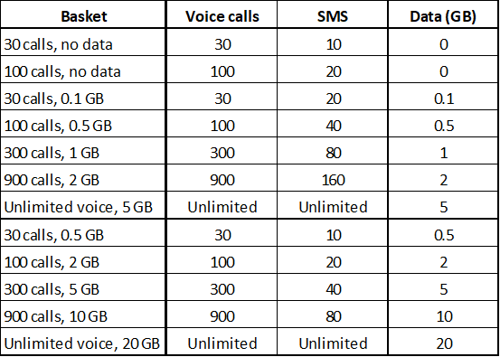
mobile voice and data baskets, 2017 definitions
There are 12 baskets OECD baskets for mobile voice/mobile voice and data:
2 baskets with no data
5 baskets with lower data use
5 baskets with higher data use
Included in the OECD 2017 definitions are two unlimited voice baskets.
Results have been presented for selected baskets only, for residential and business separately.
The 2017 baskets are shown in the table below.
Page 4

Slide 5
Fixed Broadband Price BENCHMARK METHODOLOGY
The fixed broadband results are produced using the OECD Fixed Broadband Price Benchmarking system, which incorporates the OECD 2017 baskets methodology for fixed broadband services. The system has been developed by the Teligen division of Strategy Analytics for the express purpose of producing the official OECD results for the fixed broadband service baskets.
This covers standalone residential pricing, and, in those instances where standalone services are not offered, pricing for basic bundled service pricing may be considered, and may feature in the results. In addition, the system has also has been extended by Teligen to include business pricing for small business users
According to OECD methodology, the top two providers by market share are covered, to achieve at least 70% market coverage.
Pricing has also been included for two fixed broadband providers in Georgia:
Magticom
Silknet/Geocell
In addition, separate pricing has been included for services in Tbilisi and for regional services.
The basket calculation takes into account the cheapest form of installation, amortized over three years, modem cost (if applicable), monthly rental (including promotional rentals if applicable), usage allowances and any usage charges.
The OECD 2017 baskets for fixed broadband are shown in the next slide. A full description of the OECD methodology can be found on the OECD website.
Page 5

Slide 6
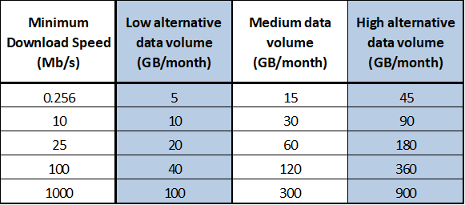
Fixed broadband basket methodology
There are 15 baskets OECD baskets for fixed broadband:
5 each of low, medium and high usage
The 2017 baskets are shown in the table below.
As many services offer very high or unlimited allowances, the OECD has selected the medium usage baskets only for publication.
Page 6

Slide 7
Notes to the results
The results shown in the following slides show the results for selected baskets from the OECD Mobile Voice and Data Price Benchmarking system and the OECD Fixed Broadband Price Benchmarking system, extended to include pricing for service providers from Georgia.
All results are presented in USD PPP (purchasing power parity) per month, including VAT.
Mobile voice and data results are based on exchange rates as of 1 May, while the fixed broadband results are based on exchange rates as of 1 June 2020.
Exchange rates are adjusted using World Bank comparative price levels (CPLs), which are available on the World Bank website. World Bank rates have been used as opposed to the typically used OECD CPLs, to take into account the fact that Georgia has been included in the results, and Georgia is not an OECD member. Rather than use two separate sources for CPLs – OECD, for the OECD countries, and World Bank for Georgia, a single source – the World Bank - has been used, for consistency.
Results show the cheapest value per country for each basket. In the case of Georgia, for fixed broadband, two separate results are included, for regional tariffs and tariffs for Tbilisi.
Page 7

Slide 8
Mobile voice and data results – Residential OECD basket 100 calls, 0.5GB
Georgia is not an OECD member state.
Page 8

Slide 9
Mobile voice and data results – Residential OECD basket 900 calls, 2GB
Georgia is not an OECD member state.
Page 9

Slide 10
Mobile voice and data results – Residential OECD basket unlimited calls, 5GB
Georgia is not an OECD member state.
Page 10

Slide 11
Mobile voice and data results – Business OECD basket 300 calls, 1GB
Georgia is not an OECD member state.
Page 11

Slide 12
Mobile voice and data results – Business OECD basket 900 calls, 2GB
Georgia is not an OECD member state.
Page 12

Slide 13
Mobile voice and data results – Business OECD basket unlimited calls, 5GB
Georgia is not an OECD member state.
Page 13

Slide 14
Fixed broadband results – residential All technologies – Georgia Custom basket 19mb/s
Non-OECD member states:
Bulgaria, Cyprus, Georgia, Malta, Romania
Page 14

Slide 15
Fixed broadband results – residential Fibre technology – Georgia Custom Basket 19mb/s
Non-OECD member states:
Bulgaria, Cyprus, Georgia, Malta, Romania
Page 15

Slide 16
Fixed broadband results – residential Fibre technology – OECD Medium Basket 25Mb/s
Non-OECD member states:
Bulgaria, Cyprus, Georgia, Malta, Romania
Page 16

Slide 17
Fixed broadband results – residential Fibre technology – OECD Medium Basket 100Mb/s
Non-OECD member states:
Bulgaria, Cyprus, Georgia, Malta, Romania
Page 17

Slide 18
Fixed broadband results – Business All Technologies – OECD medium basket 10mb/s
Non-OECD member states:
Bulgaria, Cyprus, Georgia, Malta, Romania
Page 18

Slide 19
Fixed broadband results – Business Fibre Technology – OECD medium basket 10mb/s
Non-OECD member states:
Bulgaria, Cyprus, Georgia, Malta, Romania
Page 19

